Slide 1
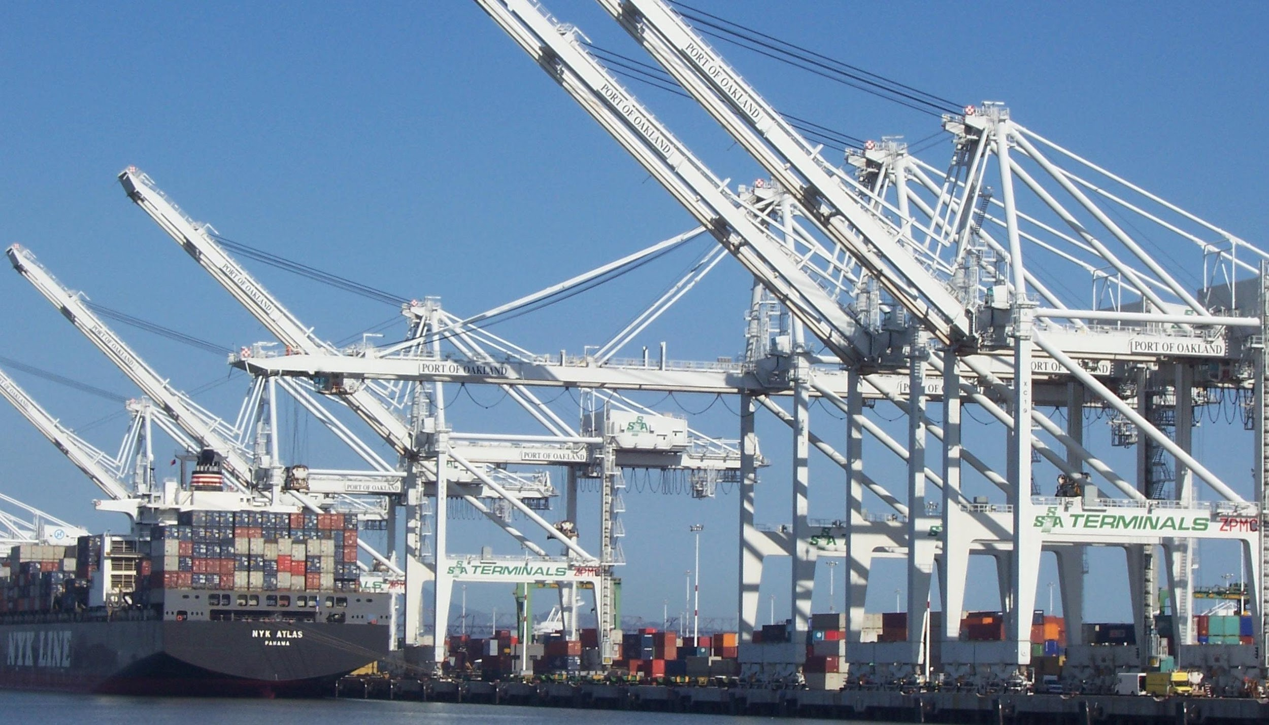



Pivotal Cloud Foundry
Architecture & Operations

Slide 2
PCF Overview
Agenda:
1) PCF overview
2) Deploying and scaling an app to PCF
3) PCF Architecture
4) PCF Services and Binding an App to a service(s)
5) High Availability and App failures

Slide 3
The Whole Stack
Notes:
Now you have seen for your selves how easy it is to relive ITOPS from the burdon of managing so many apps! You know know first hand how to better utilize your developer talent to maximize innovation.
So what’s going on under the hood?
The elastic runtime is where apps are pushed, staged, deployed, and managed.
BOSH is used for the orchestration of the entire system.
High availability comes in several flavors too.
Now lets discover together how elegant of a solution PCF really is!
--
You should never give this presentation to folks who have not seen a basic CF demo. You want to use the push of an app, with a service binding (i.e. spring-music) as the backstory for this deck.
The story line for this deck is:
you’ve seen us deploy and scale and app; we want to show you how it’s done.
This deck is intended to instill confidence in our customers, that they can trust their application to our platform. Cloud foundry is implemented with well understood patterns for distributed, web-based computing that result in extreme scalability and resilience. We know cloud and distributed systems.
We have two main layers:
The part that runs your apps (the elastic runtime)
And a whole ‘nother, kickass system, BOSH, that manages the elastic runtime and services
Let’s see how the elastic runtime deploys your app, supports service bindings and scales your app.
Let’s then see how BOSH deploys clusters, such as the elastic runtime, and services.
BUT that’s not all! Now show that the platform does SO much more than just deploy apps or clusters. → The four levels of HA.
Point out similarity of patterns between the ERS and BOSH. These are some of the patterns for distributed systems. This instills confidence.

Slide 4





A Multi-Cloud Platform: Cloud Foundry
Jenkins Service
(CI)
Elastic
Container
Runtime
Agile Microservices
Redis
MySQL
Rabbit MQ
DataStax
Cassandra
Elastic managed runtime service integrated into leading data services; all scaled and managed by CF BOSH
Cloud Foundry BOSH
Multi-Cloud Declarative Service Deployment, Operations
Azure
Notes:
Here we have a birds eye view of PCF
-- Deployed over your favorite IaaS solution is our Elastic Runtime – a set of microservices that defines PCF
-- Several application services are integrated into the platform like Jenkins, Messaging, Caching, Hadoop, etc, the list is always growing!
-- The deployment is managed by OSS Cloud Foundry BOSH which we simplify via Ops Manager, a web based management interface
----
When I can, I like to whiteboard this picture – interactive.
Start with the elastic runtime
Managed by BOSH
IaaS agnostic
Other services/clusters managed by BOSH – KV Store, … and even partners, i.e. Jenkins.

Slide 5




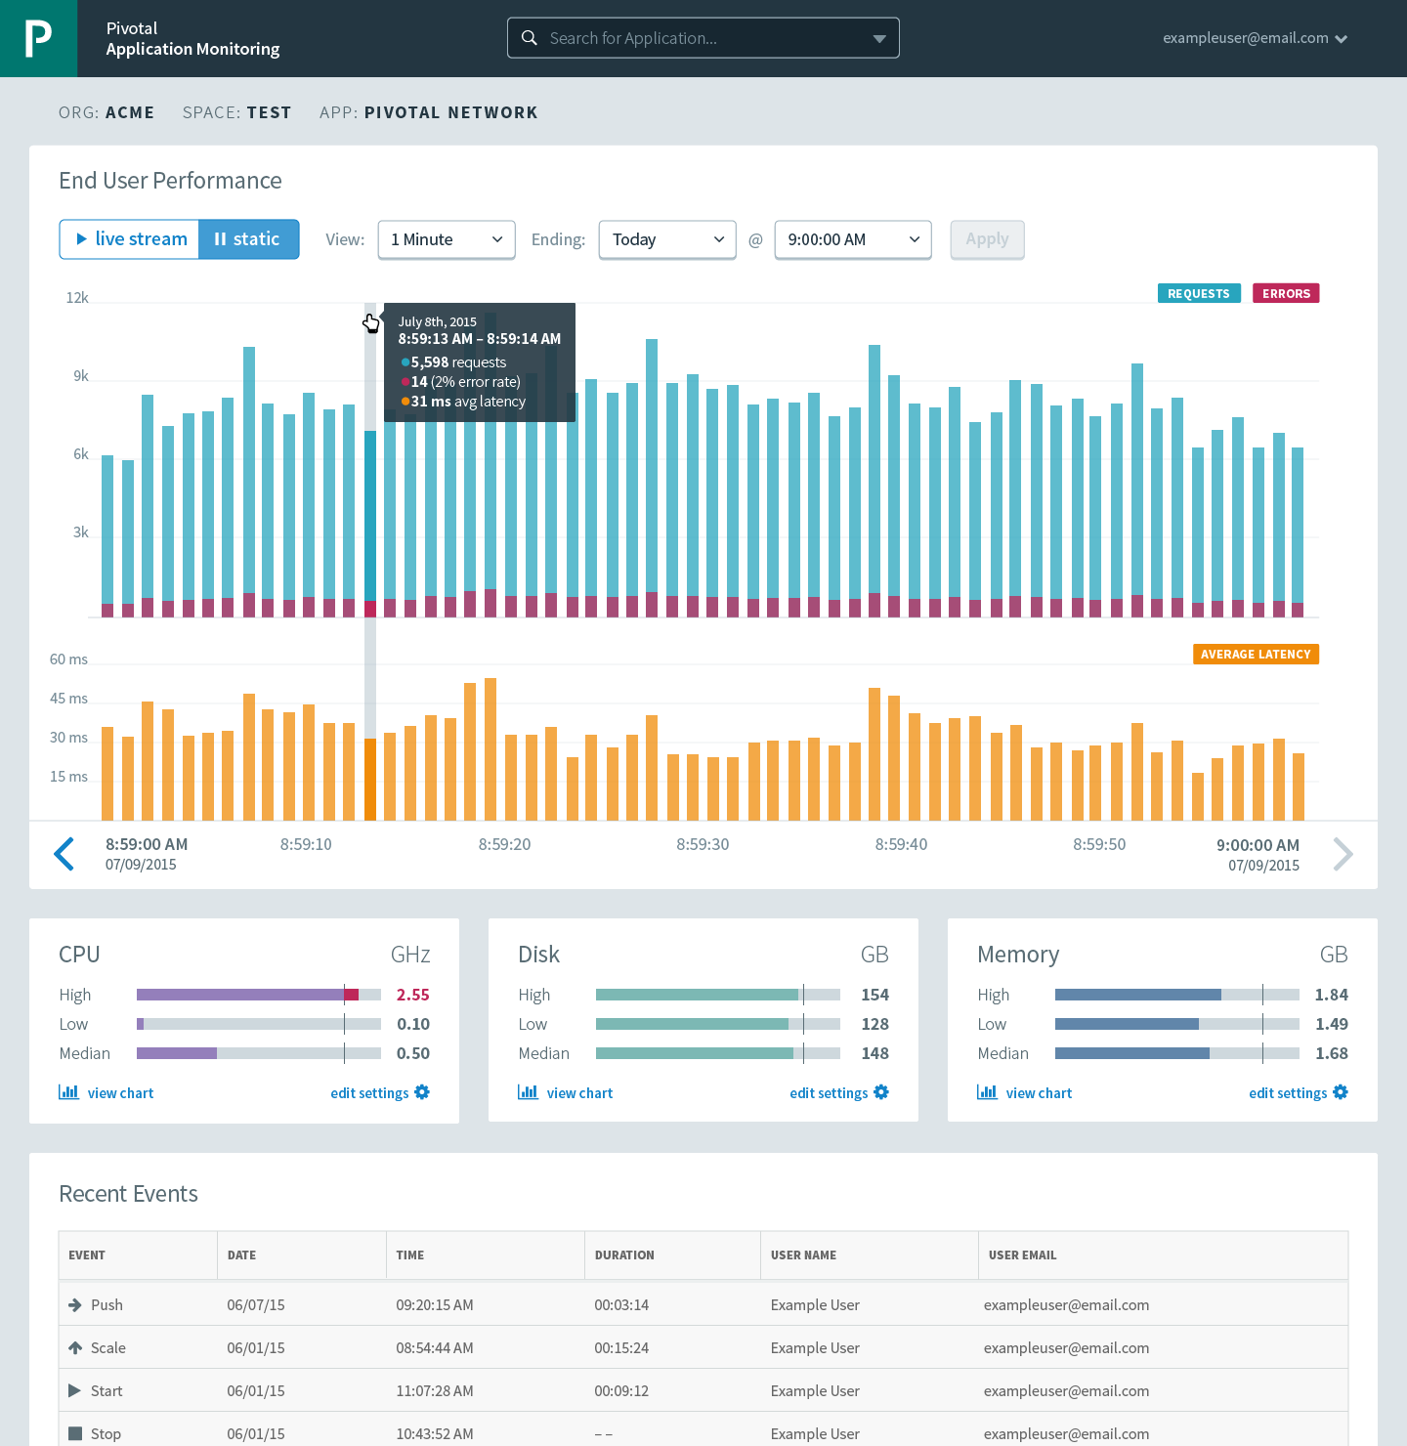



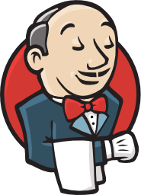

Cloud Foundry: An Application-centric Platform
Mobile Services
Centralized Log Management
Networking
& Load Balancing
Auto-Scaling
APM & Tracing
APPLICATION
Health management
Full Stack CI/CD platform
Notes:
So Spring Boot/Cloud meant create apps fast – But Dev & Ops is asking Day2 questions -
How do you do logging, routing, apm, scaling, and lifecycle management of all these apps.
Enter CF Runtime
best in class container management
integrated agentless logging
with APM
auto scaling
Effortless runtime with minimum human operational overhead. We run 1000s of apps and 10,000s containers on PWS with 6 guys.
But we realized that stopping there wasn't enough

Slide 6
Pivotal Cloud Foundry Architecture
Platform Runtime (Elastic Runtime)
Services
Routing
Container Scheduling
Service Discovery
Configuration
Database
Application Framework
Big Data
12 Factor Apps
Microservices
RESTful Services
Circuit Breakers
Object Storage
Mobile
Spring Boot
Ruby on Rails
Node.js
.NET
Build CI
Logging & Metrics
Messaging
User Provided
Operations
Zero Downtime Deployments
Failover & Recovery
Scaling
Security Patching
Platform
Upgrades
Notes:
Before diving into BOSH we introduce the major components of the platform. Then we explain the platform infrastructure automation capabilities in the context of our structured (or opinioned) platform. The following BOSH sections would explained in more detail.
PCF is made of 3 major components – Operations (Ops Manager), Platform Runtime (Elastic Runtime) and Services. All, mostly deployed, by BOSH
Now we’ll briefly talks about the components

Slide 7
Elastic Container Runtime
Technical Drill Down
Notes:
Now dive into the ERS
http://docs.pivotal.io/pivotalcf/concepts/architecture/

Slide 8
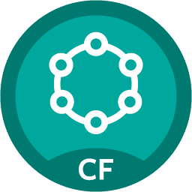
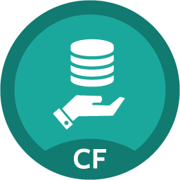
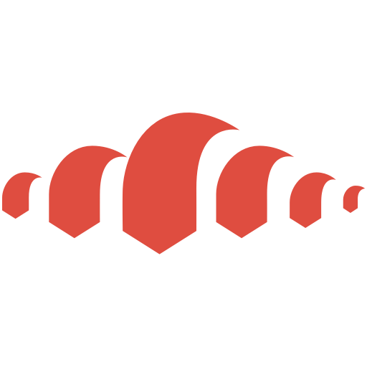
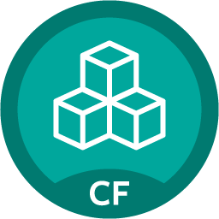

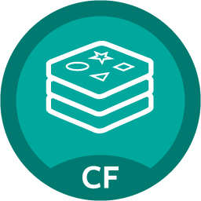

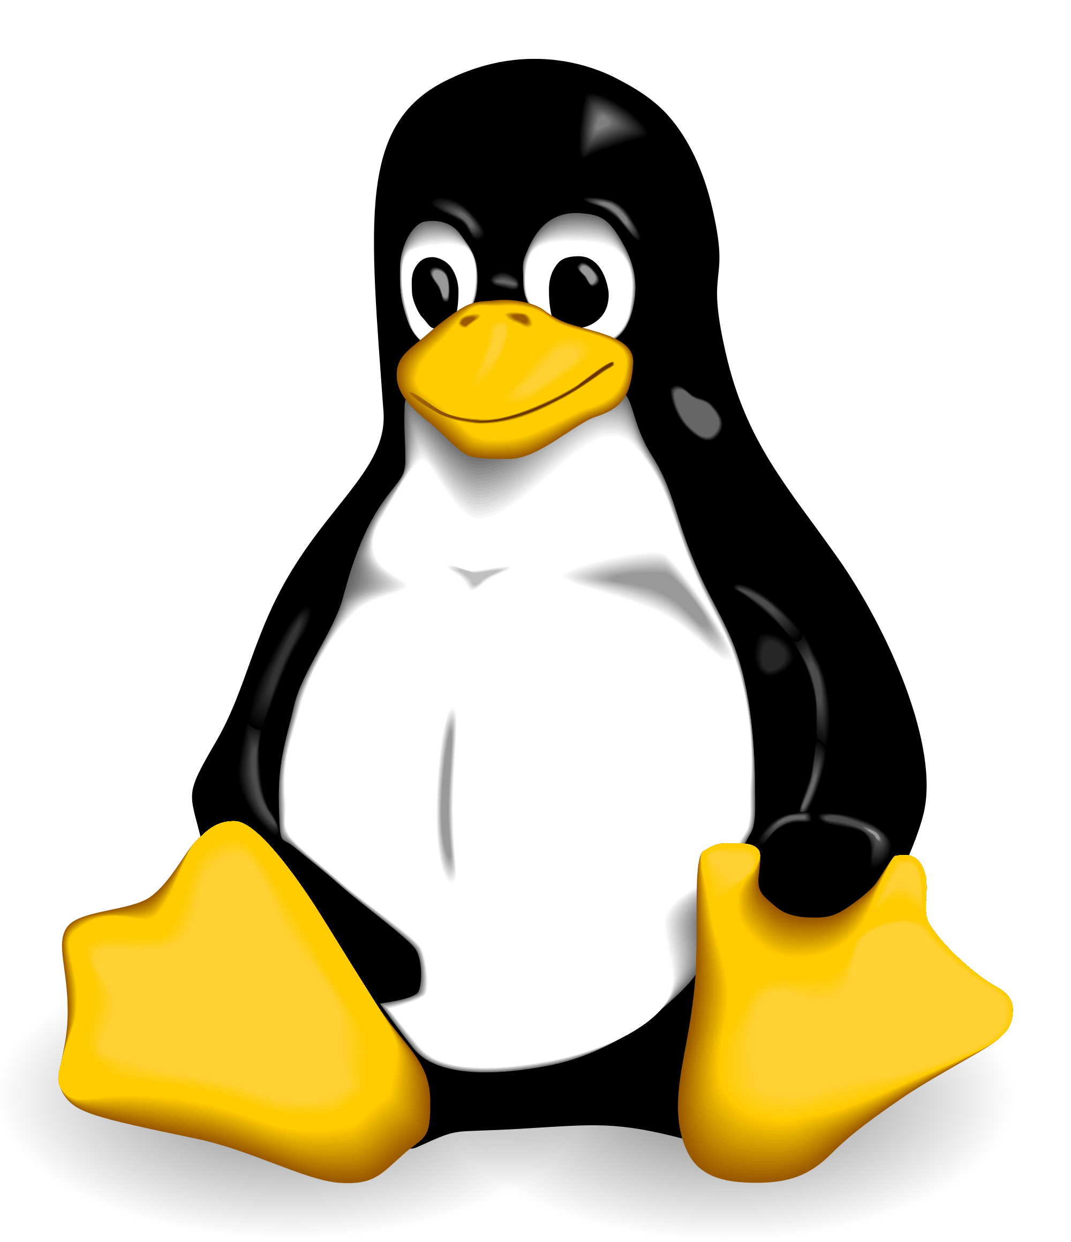
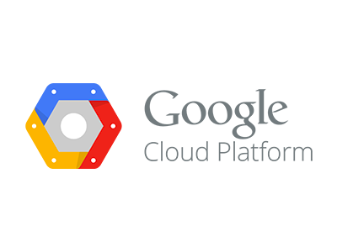
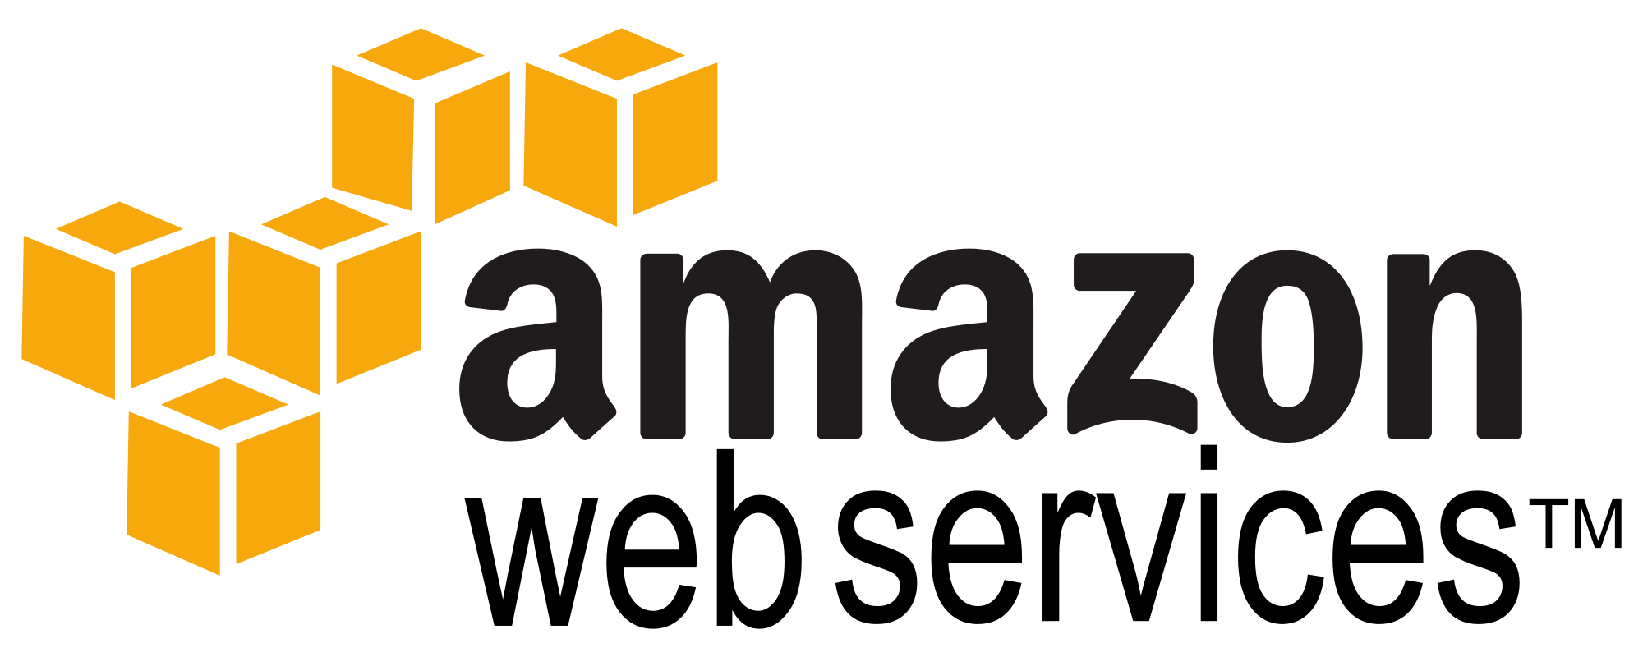
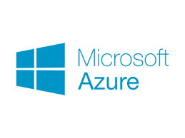
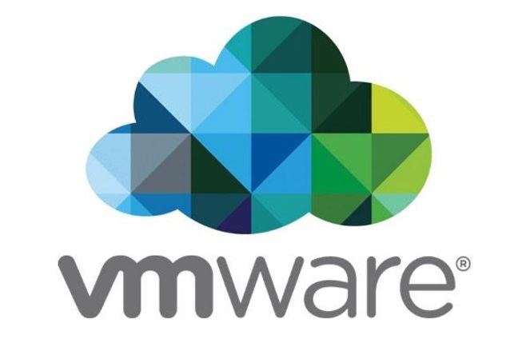

Pivotal Cloud Foundry - Architecture
UAA
Logs and Metrics
Router
Brain
System Components
Common Garden API
Partner
Services
Pivotal
Services
Garden Linux Cells
Garden Linux Cells
Garden Windows Cells
BOSH - Automation Layer
Notes:
After years of collaboration w/ MSFT and CF community
.NET apps are going to be first class citizens in Cloud Foundry
Same “cf push” experience with support for “day 2“ Operations – log aggregation, HA, scaling etc
Almost any .NET application will run as long as architectural principles of 12 factors/cloud native architecture are followed
Provides Windows containers with fast startup & high app density per host
Also Docker support is now beta with 1.6 (graduated from “experimental”)
Diego only supports secure registries bearing certificates signed by a common CA. Support for self-signed certs or custom-ca certs will be introduced in a subsequent release.
Day 2 Ops better w/ Enhanced Runtime – faster scaling, faster self healing, run highly elastic workloads at scale.
Security features
Operators can enforce secure traffic to the network edge of the platform in order to reduce the vulnerability of each application’s data in flight.
PCF Operators can enforce secure connections from their load balancers to the VMs on which the CF routers run, whereas before that termination happened at the load balancer. This improves the security of the traffic between applications and clients.
Ensures that a default CF installation doesn’t contain insecure or unsupported versions of application runtimes

Slide 9


D E M O
Notes:
Push an App, show the logs

Slide 10

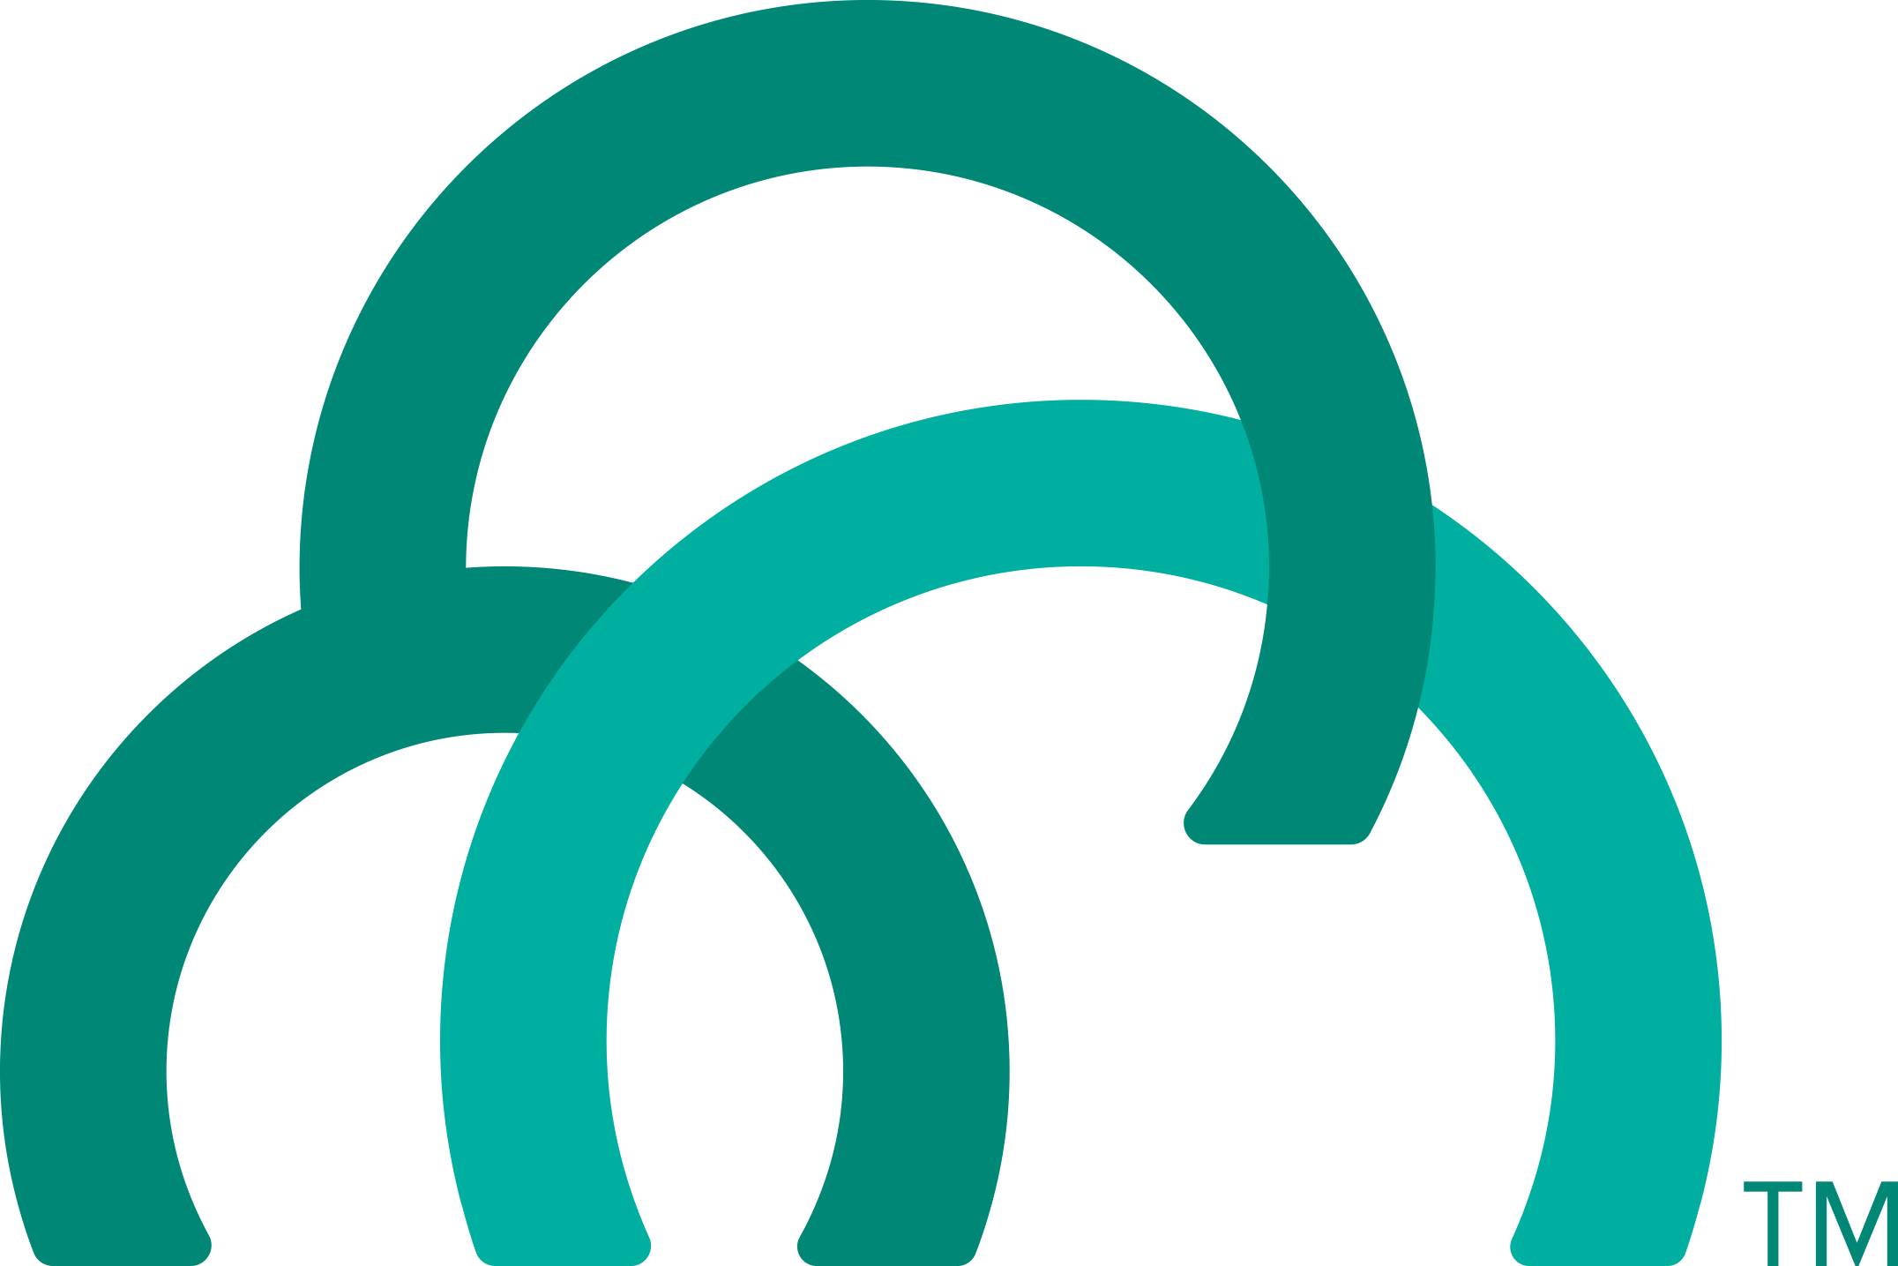
Overview: Pushing an Application
Blobstore
DB
Service
credentials
Upload app bits and metadata
Stage
Cloud Controller
Service Broker Node(s)
Deploy
push app
+ app MD
Cloud Controller Bridge
BBS / etcd
Create and bind services
Stage application
Deploy application
Manage application health
Router
CELL
Brain
DEA
DEA
Auctioneer
+
=
Task
LRP
Runtime
Notes:
Cloud Foundry PaaS
An application runs in a CELL, which is a droplet execution agent. The Cloud Controller orchestrates the routing and lifecycle of all DEAs in the pool. Routers manage application traffic. Health Manager reports mismatched application states to the CC. A service gateway provides an interface for services (native or external). A messaging bus manages all system communication. Apps are accessed directly through the router while web and CLI clients (e.g., vmc, STS) access Cloud Controller via RESTful services.

Slide 11
Creating and Binding a Service
Service
credentials
DB
CLI
create service (HTTP)
Cloud Controller
create service (HTTP)
Service
Broker
reserve resources
Data
Service
Router
bind service (HTTP)
bind service (HTTP)
obtain connection data
Runtime
http://docs.pivotal.io/pivotalcf/services/

Slide 12
Staging an Application
Staging Request
Task
Blobstore
Cloud Controller
Cloud Controller Bridge
BBS / etcd
Service
credentials
CELL Auction
Brain
DB
Auctioneer
Router
CELL
System
Buildpacks
Detect
Compile
Upload
No
Yes
Python
+
=
Java
Runtime

Slide 13
Platform Runtime – Application Frameworks
Container image
application layer
PCF buildpacks provide full support and maintenance for 3 of the 4 layers of the container stack
Devs can focus on just the app code
PCF creates the container image for you
runtime layer*
Dev Supported
PCF Supported
OS image
App container
Ops Supported
linux host & kernel
* Devs may bring a custom buildpack
Notes:
Introduction to buildpacks
Here we can compare and contrast with other container solutions like docker. We can bring up the advantages on the fact the container is built on the fly and that the buildpack provides consistency in building, updating and patching container images. Sometimes infrastructure people get’s concerned about the fact we bring our own OS images (stemcells) in regards to their “special” security and other needs. We need to find a subtle way to explain these “special” needs are often part of the problem. We should defer any detail security discussion as it can get hairy.

Slide 14
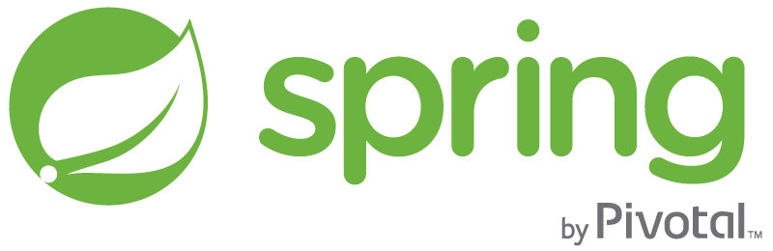
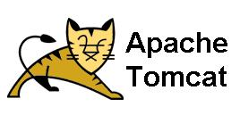
Runtime Benefits With PCF
runtime layer
6 Language Runtimes Maintained with Buildpacks
Java, Node, Python, PHP, Ruby, Go
Enterprise Support with Buildpacks
or Docker Images
Enterprise Middleware Support
Apache Tomcat Support from #1 Committer
Enterprise Framework Support
Spring is the #1 Enterprise Java Framework

Slide 15
Buildpack Flavors
Buildpacks installed into a Cloud Foundry instance or loaded from an external location at app deployment time
Buildpacks provided by public Cloud Foundry
Java Buildpack
Cloud Foundry Community Buildpack
Write you own
Java
Ruby
Node.js
Binary
Go
Python
PHP
Staticfile
Notes:
Java
Ruby
Node.js
Custom Build packs

Slide 16

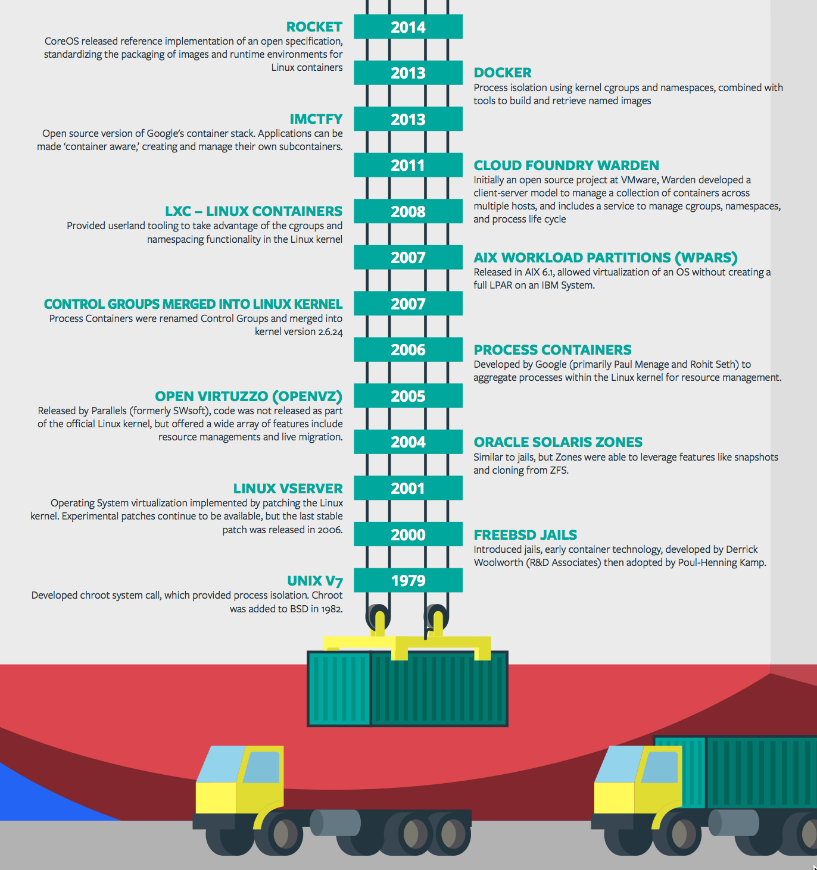
Containers - History
CONTAINERS!!!!
Containers are not new
CF has used containers since it’s inception
CF supports multiple container technologies as first class citizens including Docker, Warden, Garden and runC
Notes:
History of Docker
- 2006 Google to use containers they built cgroups and namespaces and pushed it to the Linux kernel
- cgroups and namespaces give you isolation (Resource Isolation and Namespace isolation)
- dotCloud and LXC fragmentation
- libcontainer created to address application portability and standard API across linux distros BUT controlled by Docker
- Open Container Project (Docker/dockerfile, CoreOS/appc). Standardiized on runC
- Standardizing the file format (dockerfile + appc = filesystem)
- Standardizing the runtime (libcontainer = runC)
- Container (Isolation + Files/metadata + Processes)

Slide 17
Containers and Scaling
Overview
Notes:
So how many people in here have heard of BOSH?
BOSH is the cloud foundry platform orchestration engine
This is the same BOSH used in open source cloud foundry, making Pivotal, the closest platform to the original CF!
Then you also know how tedious it can be to manage orchestration via manifest files, hence we created Ops Manager to make an easy way to work with it.
http://bosh.io/docs/about.html
https://bosh.io/docs/bosh-components.html

Slide 18
D E M O
Notes:
Scale an app

Slide 19
The App-Container Approach - Scaling
Blobstore
Cloud Controller
Container Management - DIEGO
Router
Access App
Brain
Cell
Cell
Cell
Platform Runtime
Notes:
https://github.com/cloudfoundry-incubator/diego-design-notes
At the core of Diego
A distributed scheduling algorithm which orchestrates where containers go and hence where application instance processes are run
Optimizing for application workloads
Implements Demand Driven scheduling of workload
Auctioneer says "I have N pieces of work, who wants them?"
Worker cells then join an auction and the winning cell of each auctioned-off piece of work gets that piece of work
Components of Diego
Tasks & Long Running Processes (LRPs)
Tasks: are processes that are run once and have a finite running time. This might be a script or job to process a piece of data
LRP: This might be a web-server or some other service that continuously accepts input and processes
Tasks are not included in Auction
Cells
Cells are where the Tasks and LRPs are run
These are most analogous to DEAs in the current Cloud Foundry architecture.
Generally one Cell per VM
Brain – implements the core scheduling (auction algorithm) functionality of Diego
Bulletin Board System/Store (BBS)
Where state of Diego cluster is stored
Up to date cache of cluster state
“Holds” CF actions
Start/Stop instances
Start one-off task processes
Backed by ETCD which acts as consistent store
Components of Diego Brain
Auctioneer – holds auctions for LRPs and Tasks
Also determines which instances are removed when scaling down
Converger - Keeps cluster state consistent using eventually consistent model
Ensures cluster state is consistent with the desired state, that is, performs convergence
Provides fault tolerance for Tasks and LRPs
Updates BBS with state of cluster
Places requests on BBS
Metric Server – Reads from Metron agents, publishes them to Doppler
Components of Diego Cell
Rep - Represents Cell in Diego
Mediates all communication with BBS where cluster state is maintained
Participates in auction to accept Tasks/LRPs
Runs Tasks & LRPs by working with Executor
Executor –
Implements HTTP API to Create and Delete Containers
Implements Executor Actions such as Run, Download, Upload, Parallel etc
Streams Stdout & Stderr to Metron agent running in the Cell
Garden – the Linux container for Diego
Garden API – the Linux Garden API implementation
Garden-Linux – the Linux container backend implementation
Isolates network, disk, memory, CPU; performs resource management
Runs droplets, tasks, other containers (Docker)
Metron Agent - Forwards application logs and application/Diego metrics to doppler (loggregator)

Slide 20
DOMAINS AND ROUTES
Notes:
THIS SECTION INCORPORATES SLIDES FROM “PCF Basics and Arch 301” Deck

Slide 21
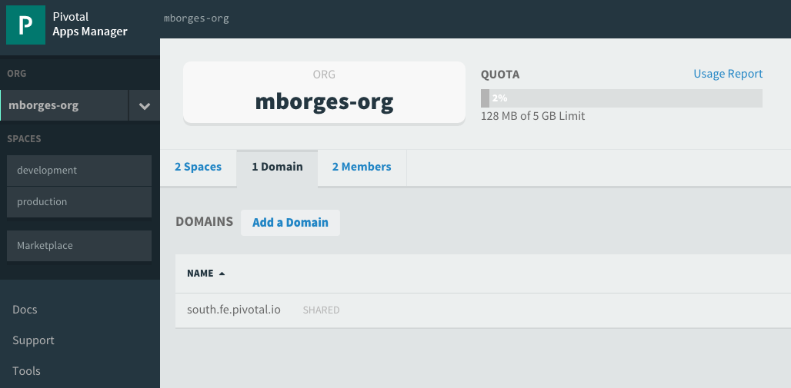
Domains
Each Cloud Foundry installation has a default app domain
Domains provide a namespace from which to create routes
Requests for any routes created from the domain will be routed to Elastic Runtime.
Domains can be shared or private in regards to PCF organizations
Notes:
https://docs.pivotal.io/pivotalcf/devguide/deploy-apps/routes-domains.html
Picture of PCF architecture HAProxy and Router using domain namesdns

Slide 22
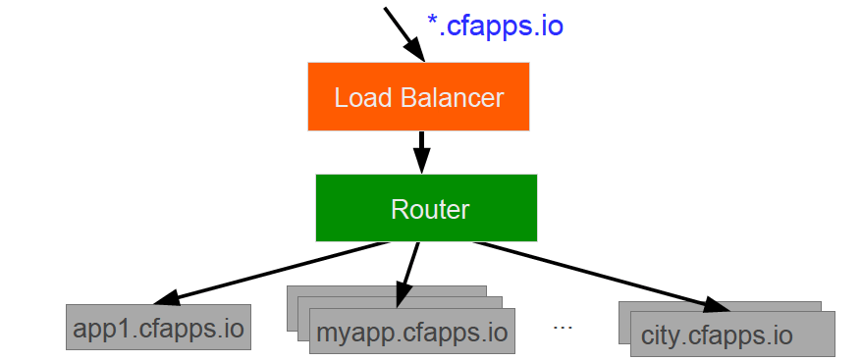
Domains – Behind the Scenes
A wildcard entry (*) is added to the DNS for the app domain
That DNS entry points to a load balancer (or Cloud Foundry’s HA Proxy), which points to the Cloud Foundry’s Router
The Router uses the subdomain to map to application instance(s)
Notes:
https://docs.pivotal.io/pivotalcf/devguide/deploy-apps/routes-domains.html
Picture of PCF architecture HAProxy and Router using domain namesdns

Slide 23
LOGGING
Notes:
THIS SECTION INCORPORATES SLIDES FROM “PCF Basics and Arch 301” Deck

Slide 24
D E M O
Notes:
“Anatomy of a Buildpack”
Show students a buildpack repo and discuss OSS CF and how each language has a buildpacks that knows how to detect the language as well as compile the droplet.
https://github.com/cloudfoundry/python-buildpack
Compile
Detect: https://github.com/cloudfoundry/python-buildpack/blob/master/bin/detect
Release:

Slide 25
Log Streaming and Aggregation
App Developers can tail their application logs or dump the recent logs from the CF CLI, or stream these to a third party log archive and analysis services
Operators and administrators can access the Loggregator firehose, the combined stream of logs from all apps, plus metrics data from CF components
Operators can deploy ‘nozzles’ to the firehose. A nozzle listens to the firehose for specified events and metrics. E.g syslog or datadog nozzle
Notes:
https://docs.pivotal.io/pivotalcf/loggregator/nozzle-tutorial.html
Avery Application instance starts streaming logs immediately
“Loggregator” component aggregates logs and streams back to different outputs
Streaming can be send directly to Splunk or other log aggregation and analytics tools

Slide 26
Log Aggregation and CF Components
Health Monitor
Syslog
Syslog Aggregator
Cloud Controller
Syslog
Logstash
Messaging (NATS)
Splunk
Syslog
Cell
Pivotal CF Elastic Runtime
…
Syslog
Notes:
Libraries = runtime package managers like Ruby gems, Node modules, Python PIP packages
App bits are downloaded into image by DEA, buildpack may move them as necessary

Slide 27
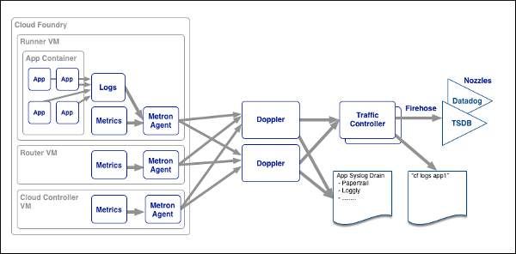
Loggregator Components
Notes:
https://docs.pivotal.io/pivotalcf/loggregator/architecture.html

Slide 28
Elastic Runtime Architecture
Turnkey, Fully automated Cloud Native Platform
Scalable runtime environment, extensible to modern framework and languages
Instant scalable with updates and upgrades with no downtime
Deploy, scale and manage applications with services
Pivotal CF Elastic Runtime
Dynamic Router
ROUTING
OAuth 2.0 Server (UAA)
Login Server
AUTHENTICATION
Cloud Controller
etcd
Auctioneer
APP LIFECYCLE
Brain / BBS
MESSAGING
Service Brokers
CELL
Blob Store
APP STORAGE
& EXECUTION
Garden
Build Packs
Sys Log
Collector
App Log
METRICS & LOGGING
Pivotal CF Ops Manager / BOSH
Notes:
TDB: Sort out the box component to be represented at a high-level. For example, should we brake down the Diego Brain and Cell?
[Cornelia Notes] This should be used as a transition to say “the elastic runtime deployed a cluster of VMs – each of the green boxes is one, usually deployed in duplicates – and BOSH/Pivotal CF OpsManager is what we will talk about now…
*** Original bullets points ***
Turnkey, fully automated Platform-as-a-Service
Scalable runtime environment, extensible to most modern frameworks and languages running on Linux
Instant expansion or upgrade with no downtime
Deploy, scale and manage applications with bindable services using simplified semantics and APIs

Slide 29

Pivotal CF Architecture - Recap
Login Server
OAuth 2.0 Server (UAA)
Blobstore
Ops Manager UI
Cloud Controller
CC Bridge
BBS
Ops Manager Director
Operations Manager
CELL
CELL
etcd
Service Broker
Rep
Exec.
Rep
Exec.
Dynamic Router
Brain
Service Nodes
HA Load Balancer
Garden
.NET
Auctioneer
Service
Converger
Metron Agent
Metron Agent
Service Broker
Access
Loggregator
Service Nodes
Traffic Controller
SSH Proxy
Service
Doppler
Log Firehose
Fileserver
BOSH
Azure

Slide 30
Pivotal Cloud Foundry
Operations

Slide 31


Pivotal CF operations
Developer
Operator

Slide 32



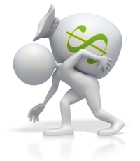
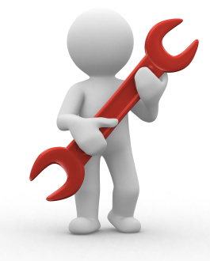





Install runtime and container
Deploy to dev
Install services (db,
messaging, hadoop, …)
Setup load-balancing, SSL termination and dynamic routing
Setup / config
High Availability
App Deployed
Setup APM
Setup log streaming

Slide 33

Blue-green deployment
Restart server
Upgrade app
Deploy to Test
Create service
Deploy to dev
Change JDK
Redeploy
Scale Platform
Scale up
Bind service
Update app
Deploy to QA
Update app server
Unbind service
Change route
Promote to production
Escale memory
Check logs
Scale down
Delete App

Slide 34







The Pivotal CF Way
Deploy to dev
Cloud
Controller
BBS
> cf push
Router
BRAIN
Access
App Deployed
Loggregator

Slide 35


Operators in the Cloud Native Platform Era

Slide 36



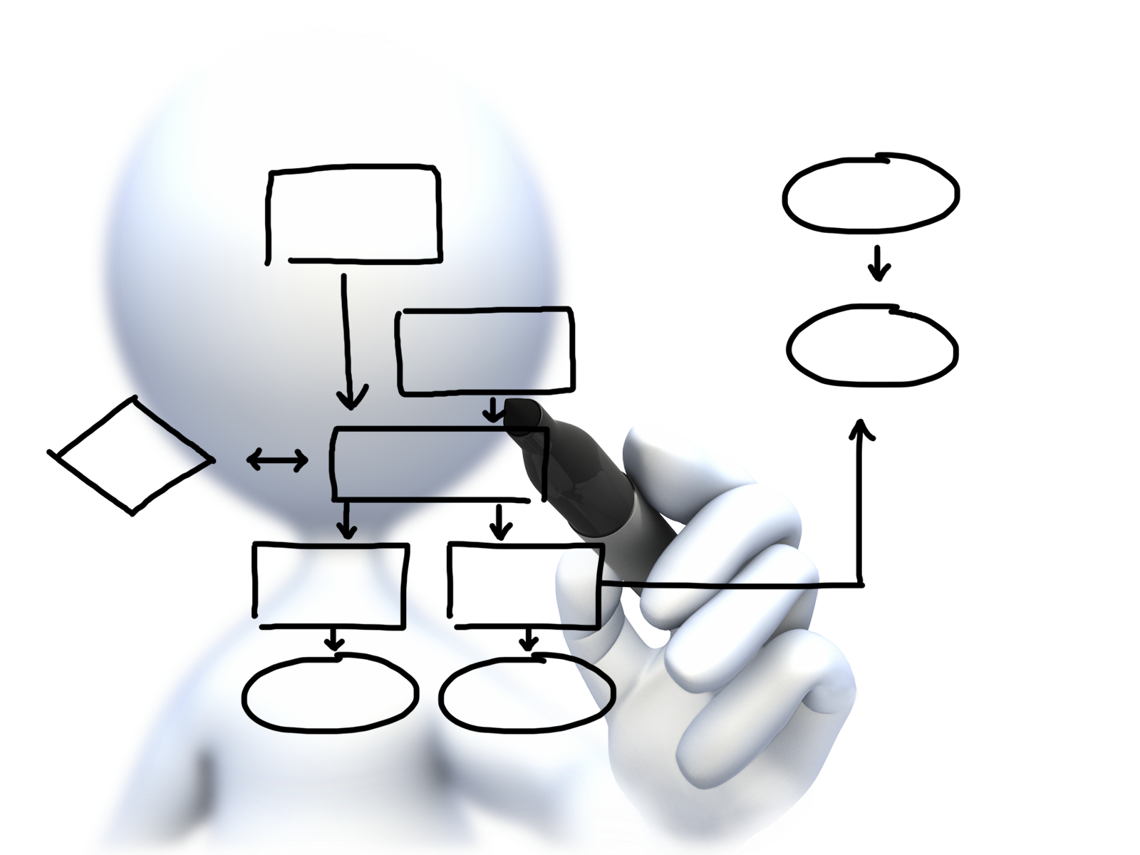


Operator
Concerns
Plan capacity
Setup High Availability
Install the platform
Manage users
and quotas
Handle upgrades and updates
Monitor the platform

Slide 37
Deploying Cloud Foundry
Overview
Notes:
So how many people in here have heard of BOSH?
BOSH is the cloud foundry platform orchestration engine
This is the same BOSH used in open source cloud foundry, making Pivotal, the closest platform to the original CF!
Then you also know how tedious it can be to manage orchestration via manifest files, hence we created Ops Manager to make an easy way to work with it.
http://bosh.io/docs/about.html
https://bosh.io/docs/bosh-components.html

Slide 38
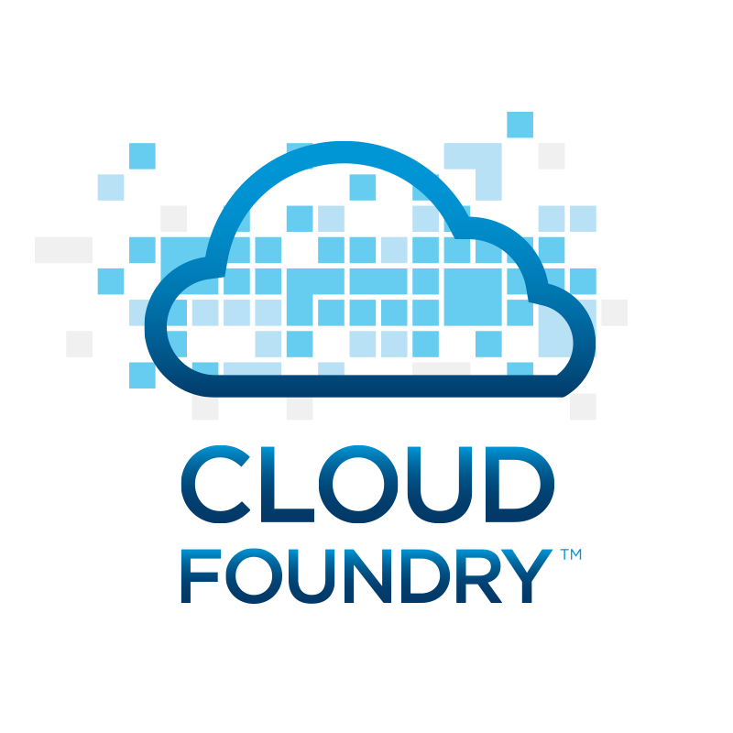


Deploying the CF Runtime with Cloud Foundry BOSH
BOSH
DB
Worker VMs
Deploy new
CF Instance
BOSH Director
Blobstore
etcd
Message Bus
Deployment
Packages
Blobs
Source
Jobs
Manifest
CELL
Health Monitor
Target VM
Cloud Controller
Target VM
Cloud Foundry Operations Manager/BOSH
Target VM
IaaS

Slide 39
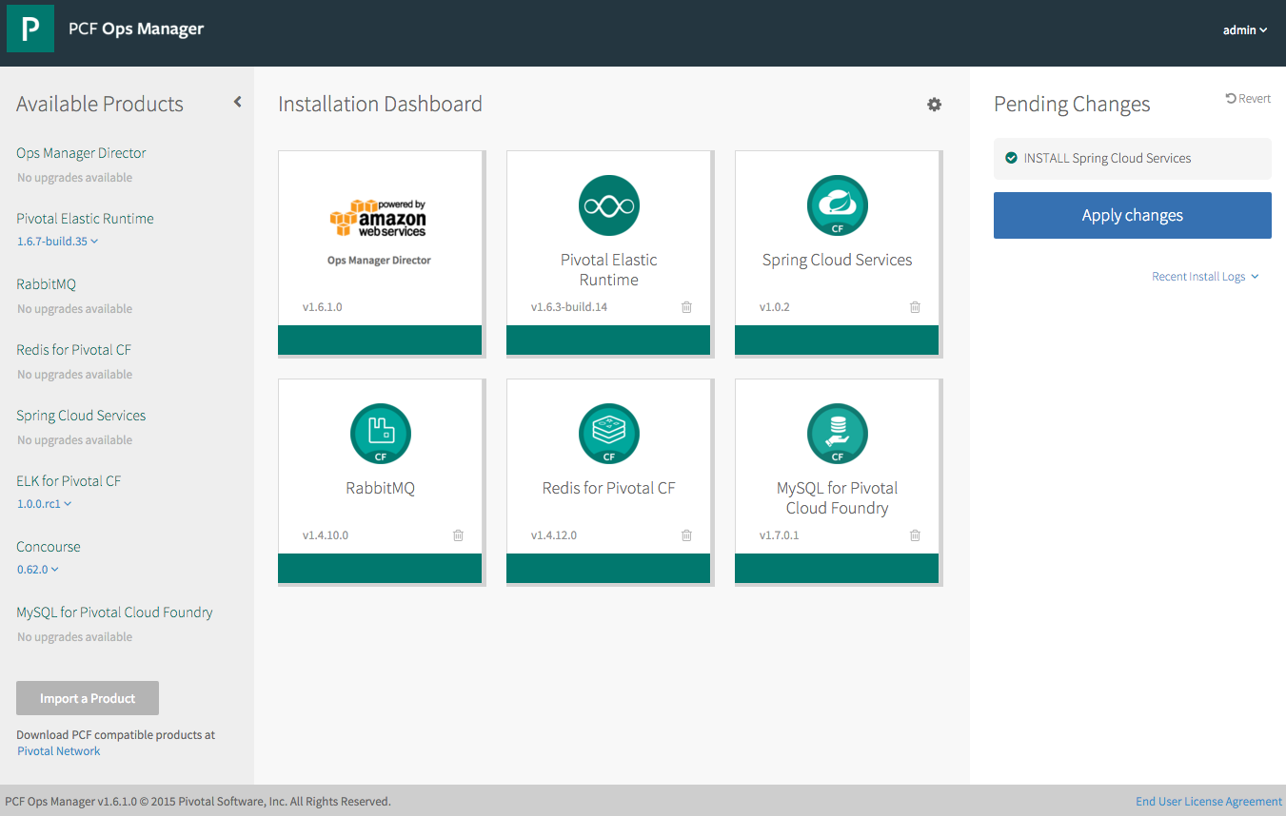
Operations - Pivotal Ops Manager
Click to Install the Platform
Built-in High Availability
Install and Manage Services
Handle Live upgrades and updates
Click to scale the platform
Built-in Platform monitoring
Notes:
http://docs.pivotal.io/pivotalcf/customizing/index.html
This picture allows us to walk thru Ops Manager. Left hand size you see some products that are not installed, you even see a new version of Elastic Rutnime (upgrades) and the Pending Changes (INSTALL Spring Cloud Services). You can talk about important products and the recent logs.
We have the Ops Director for AWS (but we support others). This is the very first tile you install and established the communication with the IaaS. Then you probably start with the Elastic Runtime, now you have a platform – basic platform services including the container runtime (DIEGO). Then you install additional services. All managed by bosh and done in a consistent manager.

Slide 40
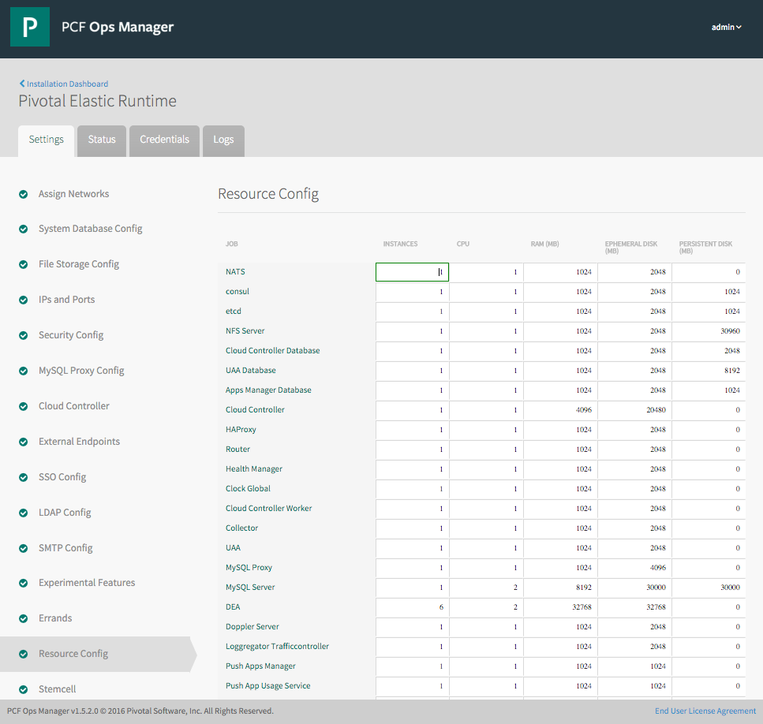
Elastic Runtime Tile
Web form allowing an operator to scale components both
vertically (CPU, RAM, Disk) and
horizontally (number of instances).
This results in updating the deployment manifest followed by a “bosh deploy.”
Notes:
http://docs.pivotal.io/pivotalcf/customizing/index.html
We can explain quiet a bit on the ERS image. We can highlight the wizard like functionality by showing the settings steps on the left and the monitoring capabilities on the status and logs tabs. We can also talk about credential management for the components of ERS. The setting step selected is the resource config which we can talk about scaling components and HA deployments.

Slide 41
Four Levels of HA
Built In!
Notes:
So how many people in here have heard of BOSH?
BOSH is the cloud foundry platform orchestration engine
This is the same BOSH used in open source cloud foundry, making Pivotal, the closest platform to the original CF!
Then you also know how tedious it can be to manage orchestration via manifest files, hence we created Ops Manager to make an easy way to work with it.
http://bosh.io/docs/about.html
https://bosh.io/docs/bosh-components.html

Slide 42
D E M O
Notes:
High Availability of Scale Demo

Slide 43
Application Instance HA
Blobstore
Cloud Controller
DB
Service
credentials
creds
Cloud Controller Bridge
Actual State
Desired State
Actual State
Re-deploy App
BBS
Converger & Auctioneer
Router
CELL
CELL
CELL
Exec.
Rep
Exec.
Rep
Exec.
Rep
Runtime

Slide 44

Platform Process HA
BBS
AGENT
Restart!
Health Monitor
Responses:
Cell
pager
AGENT
pager
Message Bus
email
email
monitoring
monitoring
…
…
Cloud Controller
AGENT
Pivotal CF Operations Manager
IaaS
Notes:
Two processed on the VMs are MONIT and BOSH agent
Monit monitors the actual state of processes, while BOSH agent is used to communicate the status to the health monitor
In a process goes down, Monit tries to restart it
If successful, or not, BOSH agent is notified, who then tell Health monitor, which will notify the operator
The processes running on the virtual machines (i.e. the health manager) are started with monit, an opensource linux utility that keeps an eye on processes and will respond when one dies. If a process dies then, monit will do two things: first, it will try to restart the process and second, whether the restart is successful or not, it will tell the BOSH agent about the failure. Recall that the Bosh agent is there to communicate with Operations Manager and in this case it will relay this failure information to the Operations Manager Health Monitor (not to be confused with the Health Manager of the elastic runtime that was discussed above) – we’ll abbreviate it OMHM. The OMHM will take this alert and pass it through a list of responders that can be configured to do things like send emails, page administrators and display alerts in operations dashboards. There’s a good chance that monit will already have recovered the process, but we also want there to be an opportunity for a human to respond.

Slide 45

Platform Virtual Machine HA
Cloud Controller
DB
Agent
Process
BOSH Director
Health Manager
Blobstore
Re-create VM
Agent
Process
Ressurector
BBS
VM is
missing…
Agent
Process
Message Bus
Health
Monitor
Cloud Controller
Agent
Process
Pivotal CF Operations Manager
IaaS

Slide 46

2. Within a DC using Availability Zones
Availability Zones are vSphere Clusters
AZ1
AZ2
AZ3
Cell
Cell
Cell
Application instances are evenly distributed over Availability Zones.
Cell
Cell
Cell
Router
Losing an AZ keeps instances running and available, and replaces those that are lost
Cell
Cell
Cell
Pivotal CF Elastic Runtime
Notes:
Zone could = rack, for example

Slide 47
Platform Monitoring
Overview
Notes:
Now dive into the ERS
http://docs.pivotal.io/pivotalcf/concepts/architecture/

Slide 48
D E M O
Notes:
Show Metrix

Slide 49
Platform Monitoring
Pivotal Ops Metrics provides a single JMX interface to access metrics for each Pivotal CF component
Cells
Cloud Controllers
Routers
Health Managers
BBS, UAA, Login Server, …

Slide 50
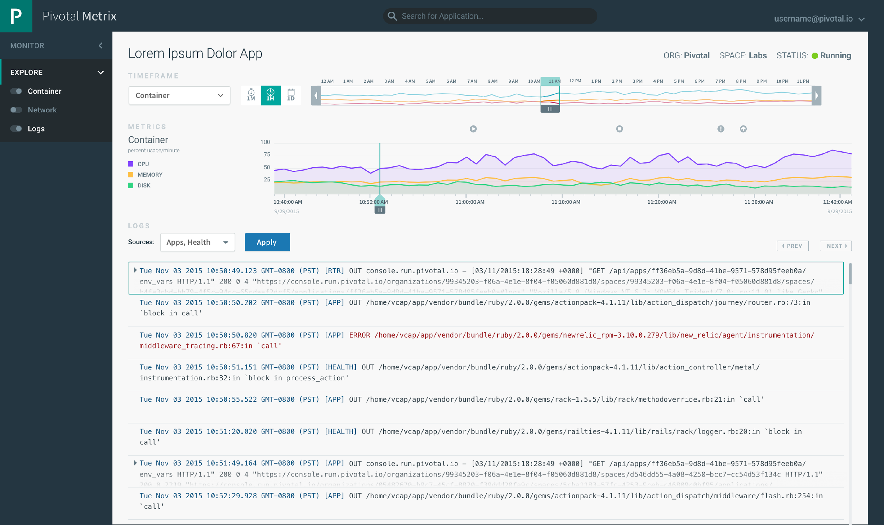
Coming Soon to ERS 1.7
Notes:
This looks a lot like Splunk
Kubernetes doesn’t have built-in logging and analytics capabilities
D

Slide 51
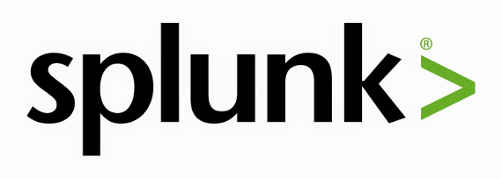
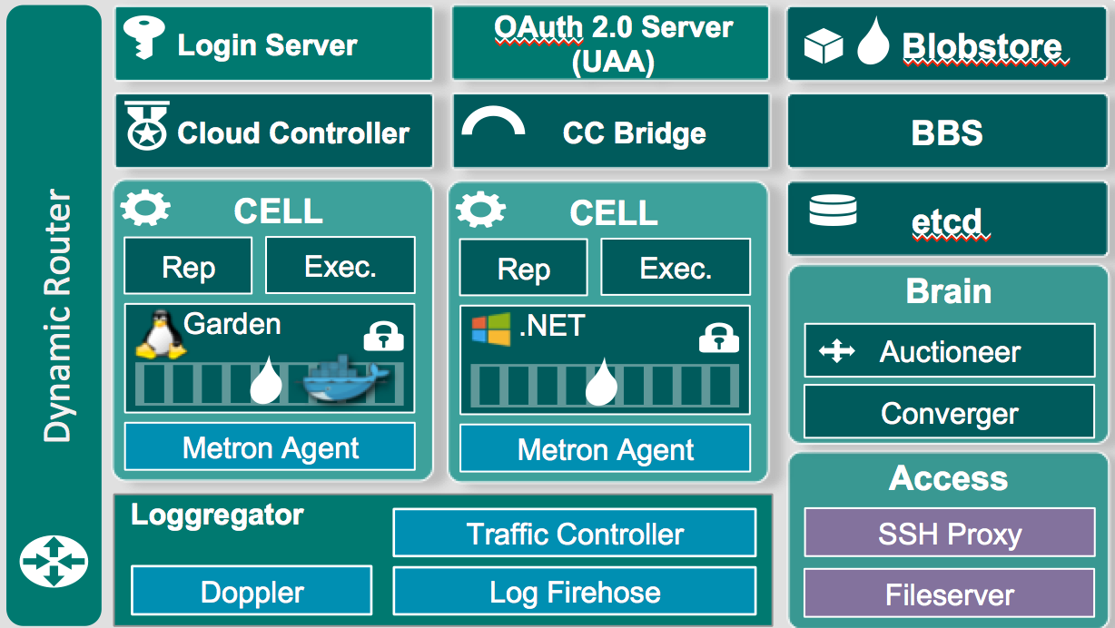
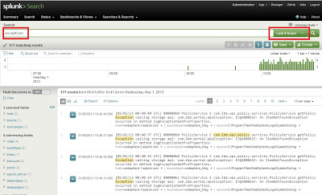
Platform Monitoring
Notes:
Need to install a plugin so Splunk can read CF logs properly
Note this isnt showing a full Splunk Arch

Slide 52
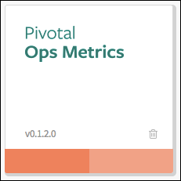
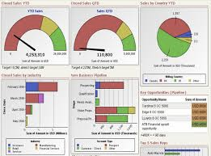
Platform Monitoring
JMX Monitoring Tool
JMX Provider
Collector

Slide 53
Multitenancy
Overview

Slide 54
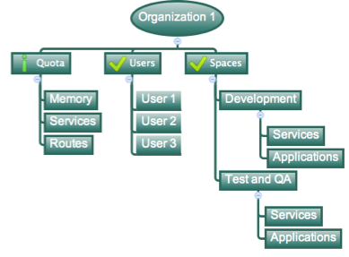
Organizations
Logical division within a Pivotal CF install / Foundation.
Each organization has its own users and assigned quota
User permissions / roles are specified per space within an organization
Sub-divided into Spaces

Slide 55

Quotas & Plans
Different quota limits (e.g. “small”, “enterprise”, “default”, “runaway”) can be assigned per Organization
Quota defines
Total Memory
Total # of Services
Total # of Routes

Slide 56

Spaces
Logical sub-division within an organization
Users authorized at an organization level can have different roles per space
Services and Applications are created / specified per Space
Same Service can have different meanings per space
Spaces can be assigned quotas

Slide 57

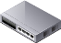

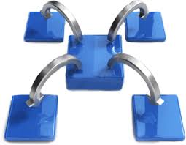
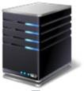

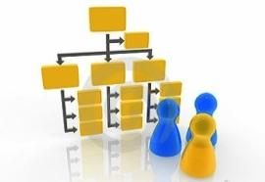





Capabilities of Pivotal Cloud Foundry
Automatic App Server & OS Configuration with Buildpacks (“just push your app”)
Application
Containerization & Cluster Scheduling
Application Network Security Groups
Application to Services Binding and Access
App Health,
Load Balancing,
Rapid Scaling, Availability Zones
Policy, Identity and Roles Management
Logging as a service,
Application metrics & performance,
Metric based scaling
Native & Extended Data, Mobile and Platform Services
IaaS Provisioning, Scaling & Configuration
Deploy, Operate, Update & Scale with minimal downtime on choice of IaaS
Azure
Notes:
Key Platform Capabilities
On Demand Scaling
Application Health Management
Dynamic Routing & Load Balancing
Log and Metric Aggregation
Security
WHAT
Pivotal CF is next generation middleware that delivers 9 things that are typically delivered via point software products.
We provision operating systems and middleware.
We deliver workload density without compromising application performance.
We ensure that applications have appropriate network security safe guards to prevent security threats.
We support application connections to external sources including databases and legacy middleware.
We provide 4 levels of HA, with built in load balancing for scale in/out
We support multi-tenant environments so that each line of business can operate with a discrete quota and isolated system access.
We provision next generation data services including NOSQL databases, traditional databases and hadoop clusters.
We provide horizontal and vertical scaling for the underlying IaaS so that you can scale your infrastructure in lock step with your Business.
We provide a built-in log aggregation service, built-in APM metrics and utilization based auto-scaling so that you can monitor the health of your applications and scale out without human or 3rd party tool intervention.
I am going to cover each of these 9 capabilities in more detail, but it’s important to note the impact of this collection of capabilities. The following slides will include information on CAPEX and OPEX reduction. We will also discuss how you can deliver faster time to value while holding the line on infrastructure cost.

